Slide 1
Housing Price prediction
Real estate Industry

Slide 2
Data Description
Houses are one of the necessary need of each and every person around the globe and therefore housing and real estate market is one of the markets which is one of the major contributors in the world’s economy. It is a very large market and there are various companies working in the domain.
Data science comes as a very important tool to solve problems in the domain to help the companies increase their overall revenue, profits, improving their marketing strategies and focusing on changing trends in house sales and purchases.
Predictive modelling, Market mix modelling, recommendation systems are some of the machine learning techniques used for achieving the business goals for housing companies. Our problem is related to one such housing company.
A US-based housing company named Surprise Housing has decided to enter the Australian market. The company uses data analytics to purchase houses at a price below their actual values and flip them at a higher price. For the same purpose, the company has collected a data set from the sale of houses in Australia. The data is provided in the CSV file below. The company is looking at prospective properties to buy houses to enter the market. You are required to build a model using Machine Learning in order to predict the actual value of the prospective properties and decide whether to invest in them or not.
For this company wants to know: • Which variables are important to predict the price of variable? • How do these variables describe the price of the house?

Slide 3
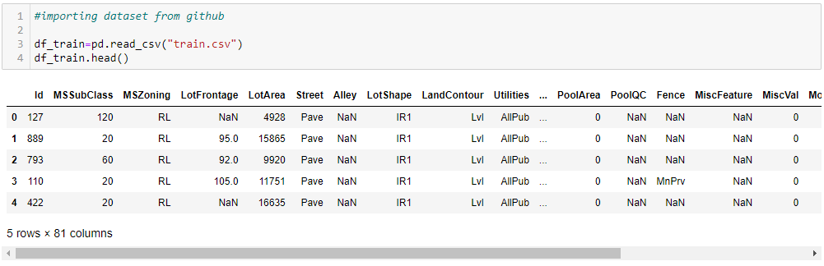
Data STRUCTURE

Slide 4
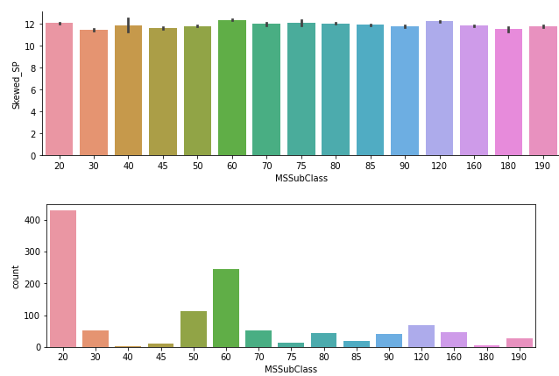
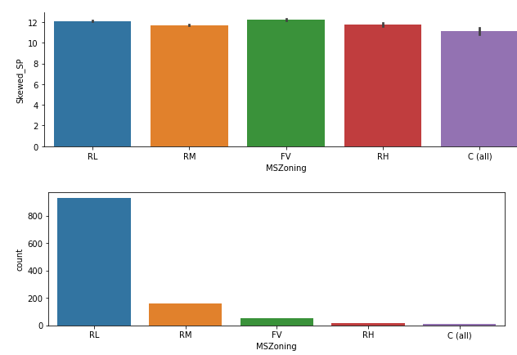
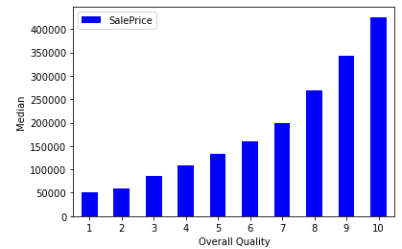
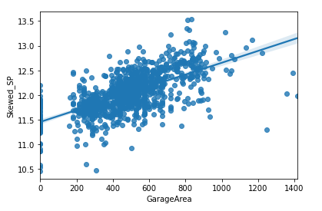
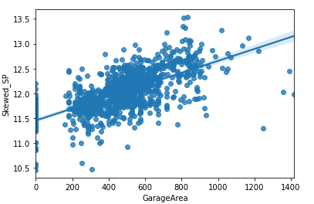
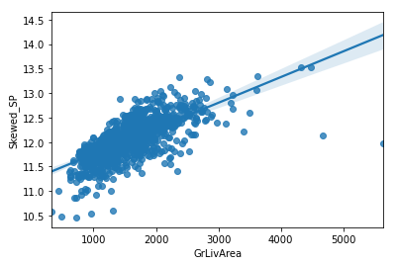
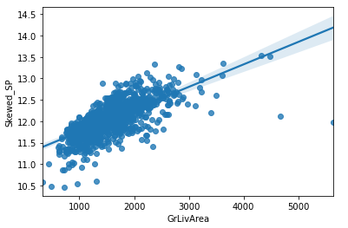
DATA VISUALIZATION

Slide 5
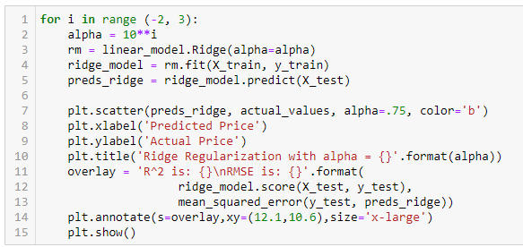
MODEL BUILDING
WE have identified this data is classification type. Hence I applied the Linear Regression algorithm,

Slide 6

Test & Train Creation
Based on the score – we can create a train and test dataset to build a model.

Slide 7
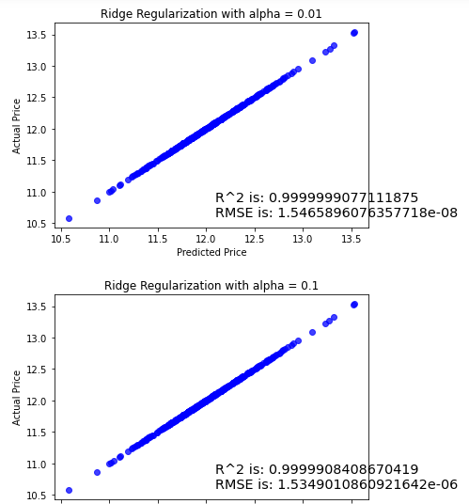
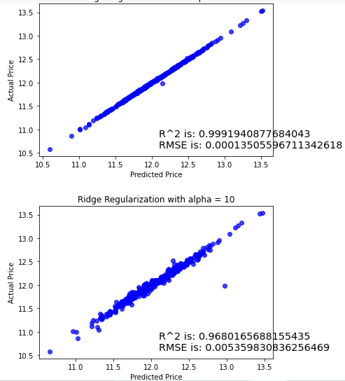
ROC CURVE

Slide 8
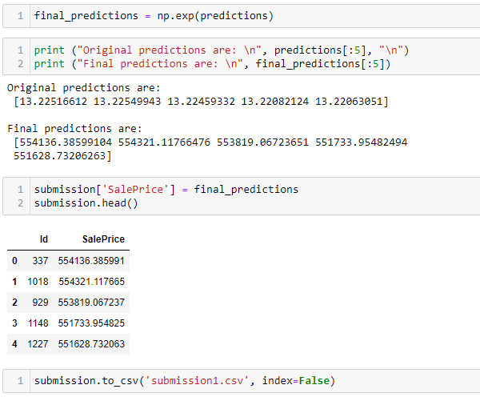
MODEL Saving

Slide 9
conclusion
Model final accuracy score is 81% - Visualization help me to understand the data and type. I performed the EDA which is outlier removal, skewness removal and standard scaling because it will help me to build model with high level accuracy.

